Slide 1

Take control of your pension savings
September 2015
David Williams (EAPF) & Martyn Slaughter (Capita)
Notes:
David

Slide 2
Contributing members briefing 2015
Agenda
Our pension Fund
How it works
Investment: Celebrating 10 years of Responsible Investment
Summary of benefits
Leaving the Scheme
State pension
The end of Contracting out
New pension rules
Taking control
Notes:
David

Slide 3
Contributing members briefing 2015
Your Fund

Slide 4
Contributing members briefing 2015
Fund background
Our pension Fund is part of the Local Government Pension Scheme (LGPS) which has over 4.5 million members
There are 89 LGPS Funds in the UK
The EAPF has over 41,000 members and £2.6 billion assets under management
There are currently 3 employers participating in the Fund:
- Environment Agency
- Natural Resources Wales
Shared Services Connected Limited
A Pension Committee & Pension Board provides strategic direction and oversight, with day to day administration provided by Capita

Slide 5
Contributing members briefing 2015
How your Fund works
Defined benefit pension schemes provide retirement benefits that are based on your pensionable pay and the length of time that you have been a member of the scheme.
Prior to 2014, this was based on your final salary
From 2014, it has been based on Career average revalued earnings (CARE)
What does this mean?

Slide 6
Contributing members briefing 2015
Investments
Investment Performance
The fund had a successful year in performance terms. The return on our assets was 15.1%, well ahead of our actuary’s assumptions.
The Fund outperformed its strategic benchmark by 0.1% (after fees), a reasonable result in a year which was more challenging for our managers.
Over three years the fund has returned 12.3% a year, 1.4% above benchmark which is a very strong result.

Slide 7

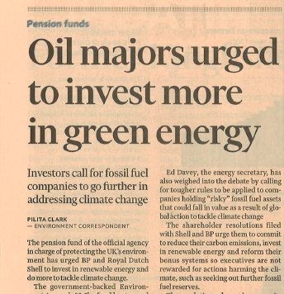

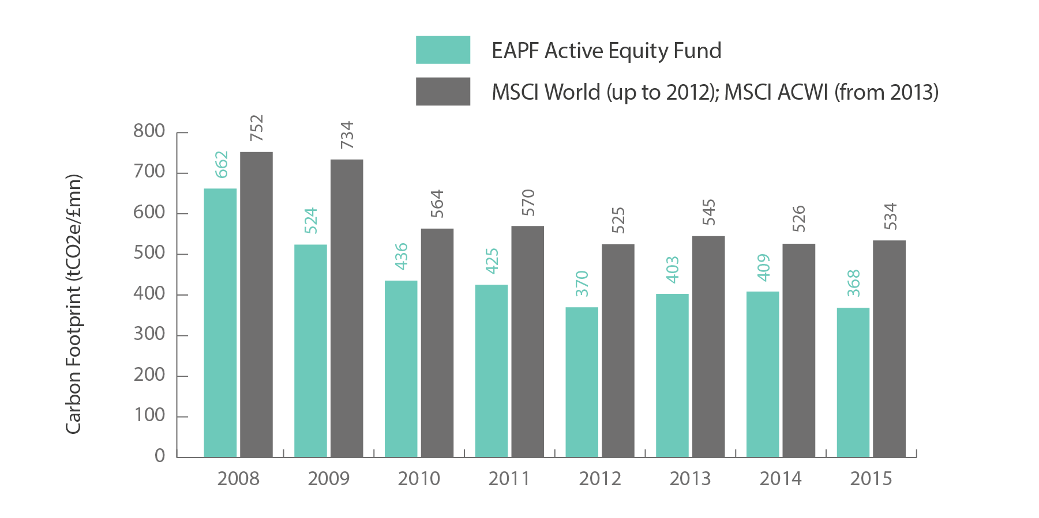

Contributing members briefing 2015
Celebrating 10 years of RI
Notes:
David

Slide 8
Contributing members briefing 2015
Your Pension
Notes:
David

Slide 9
Contributing members briefing 2015
Summary of pension benefits
Pension for life increasing in line with inflation
Option to exchange part of your pension for a tax free lump sum at retirement
Tax relief on contributions
The option to vary your contributions
Tax free life cover equal to 3 X your pay
Pension for dependants
Ill health cover
Benefits are protected in statute

Slide 10
Contributing members member briefing 2015
Calculating your pension
Membership | Pension | Lump sum
To 31 March 2008 | 1/80th annual pension | 3/80th lump sum
1 April 2008 to 31 March 2014 | 1/60th annual pension | No automatic lump sum Commute 25% of capital value of total pension
From 1 April 2014 | 1/49th annual pension + revaluation | No automatic lump sum Commute 25% of capital value of total pension
The maximum lump sum you can take is 25% of the Capital value of your total pension, and this includes any automatic lump sum you have already built up if you were a member of the Scheme before 2008

Slide 11
Contributing members member briefing 2015
Benefits built up prior to 1 April 2014 - Example
Member joined 1 April 1998
Leaves 31 March 2019
Pension
Accrual rate | X Membership | X Final pay | = Annual pension
1/80th | 10 years | £35,000 | £4,375
1/60th | 6 years | £35,000 | £3,500
Total pre 1 April 2014 pension |  |  | £7,875
Automatic Lump Sum
Accrual rate | X Membership | X Final pay | = Annual pension
3/80th | 10 years | £35,000 | £13,125

Slide 12
Contributing members briefing 2015
Benefits built up from 1 April 2014 - Example
2014 LGPS CARE | 2014 Defined Benefit | Pensionable Pay paid during scheme year (pay rises 1% pa) | Earned Pension at end of scheme year | Value following Treasury Order revaluation at start of year:
 |  |  |  | 2015/16 (Year 2) 1.2% | 2016/17 (Year 3) 2% | 2017/18 (Year 4) 2% | 2018/19 (Year 5) 2% | 2019/20 (Year 6) 2%
Pension for 2014/15 (Year 1) | 1/49th | £33,634 | £686 | £694 | £708 | £722 | £736 | £751
Pension for 2015/16 (Year 2) | 1/49th | £33,970 | £693 |  | £707 | £721 | £735 | £750
Pension for 2016/17 (Year 3) | 1/49th | £34,310 | £700 |  |  | £714 | £728 | £743
Pension for 2017/18 (Year 4) | 1/49th | £34,653 | £707 |  |  |  | £721 | £735
Pension for 2018/19 (Year 5) | 1/49th | £35,000 | £714 |  |  |  |  | £728
Value in Account |  |  |  | £694 | £1,415 | £2,157 | £2,920 | £3,707

Slide 13
Contributing members briefing 2015
Protections
Your pension before 1 April 2014 is protected and there is no change to your normal retirement age
Your current 85 year rule protections will also apply
If you voluntarily retire between age 55 and 60 we will not apply the 85 year rule protections
You may have statutory underpin protections

Slide 14
Contributing members briefing 2015
50/50 Section
Option to pay ½ contributions in return for ½ the benefits
1/49th to 1/98th
Intended as a short term solution to financial hardship
Re-enrolled in ‘main scheme’ under automatic enrolment
No change to Lump sum death benefit and ill health benefits

Slide 15
Contributing members briefing 2015
Nominating beneficiaries
Nominate who you want to receive a death grant in the event of your death
Not legally binding, but the Environment Agency Pensions Committee will take account of your nomination
Helps to get payments to your loved ones quickly
Payments made in this manner are not subject to inheritance tax
Forms available at www.eapf.org.uk

Slide 16
Contributing members briefing 2015
Survivor’s pensions
  Payable to your
  Spouse (including same-sex marriages)
  Civil Partner
  Cohabiting Partner
      Leavers after 31 March 2008 only
Eligible children
Up to age 23 in full time education
Any age if unable to work due to permanent incapacity or impairment

Slide 17
Contributing members briefing 2015
Leaving the Scheme
Leaving before 55
- Opting out
- Deferring
Normal Pension Age (NPA) aligned with State Pension Age (SPA) at point of payment
Early retirement
- From age 55
Late retirement
- To age 75
Employer consent
- Partial retirement (Flexible)
- Ill health
- VERS & Compulsory redundancy

Slide 18
Contributing members briefing 2015
Leaving with employer consent
You need employer consent for:
Partial retirement (Flexible)
Ill health retirement
Voluntary early release (VERS)
Compulsory redundancy
Switching on the 85 year rule
You can find operational instructions on our Easinet
People matters/pay and benefits/pensions/retirement

Slide 19
Contributing members briefing 2015
Tax relief
Tax relief on all your pension contributions including:
Main Scheme
Additional Voluntary Contributions (AVC)
Additional Pension Contributions (APC)
Some restrictions apply to how you get your money
HMRC apply 2 tests on the amount of tax relief you receive
Annual allowance
Lifetime allowance

Slide 20
Contributing members briefing 2015
Tax relief
 | Annual allowance | Lifetime allowance
Maximum limits 2015/16 | £40,000 - £80,000* | £1.25 million
Maximum limits 2016/17 | £40,000 | £1 million
Tapered annual allowance From 2016/17 | Tax relief is reduced by £1 for every £2 of adjusted income** of between £150,000 and £210,000
The EAPF will directly contact members who may be close to exceeding these tax limits.
*The current tax year will be split into 2 periods, running from (1) 1 April 2015 to 8 July 2015 & (2) 9 July 2015 to 5 April 2016. The AA for the first period would be set at £80,000 and the AA for the second period would be set at £40,000. However, if the member’s pension growth for first period is above £40,000, the AA for the second period is reduced by that amount (minimum £0)
**Adjusted income includes taxable income plus pension contributions and individuals’ pension input amount less value of the pension contributions

Slide 21
Contributing members briefing 2015
Your State pension
The State pension for men and women is currently being equalised
Under current legislation, SPA is planned to increase as follows:
  Age 66 born between April 1954 and April 1961
  Age 67 born between April 1961 and April 1978
  Age 68 born after April 1978
There will be a review of these dates in May 2017
Increase in minimum pension age
The 2014 budget indicated the government’s future intention to link the minimum pension age to exactly 10 years before a person’s State pension age but this has not been enacted to date

Slide 22
Contributing member briefing 2015
Your State pension
The 2014 Pensions Act introduces a new flat rate Single Tier State pension from retirees after April 2016:
Need 35 qualifying years for a full pension
The maximum flat rate State pension will be £151.25 a week
Applicable to new pensioners from April 2016
It applies to:
Women born after 5 April 1953
Men born after 5 April 1951
To calculate or forecast your State pension contact www.uk/calculate-state-pension

Slide 23
Contributing member briefing 2015
Your State pension
As a member of the LGPS you are currently contracted out of the additional State Pension
You pay lower NI contributions to reflect this
This will change in April 2016 and you and your employer will pay higher NI contributions
You may not receive the full new State pension
You can find out more at www.uk/calculate-state-pension

Slide 24
Contributing members briefing 2015
The end of Contracting Out
Member earns £24,000 pa (£2,000 pm)
Based on presumed 2016/17 tax & NI thresholds
Pension contributions of 6.5%
Contracted out
Not contracted out
Monthly pay | Deductions
£2,000 | £130 (pension)
 | £194 (tax)
 | £140.79 (NI of 10.6%)
Take home pay = £1,535.21
Monthly pay | Deductions
£2,000 | £130 (pension)
 | £194 (tax)
 | £159.36 (NI of 12%)
Take home pay = £1,516.64
Further information can be found on our The new State Pension Q&A factsheet at our website www.eapf.org.uk/publications
Take home pay reduced by £18.57

Slide 25
Contributing members briefing 2015
Member flexibility and choice
Notes:
David

Slide 26
Contributing members briefing 2015
New pension rules
From April 2015 defined contribution schemes have more freedom in how you use your pension pot if:
You have a defined contribution pension pot from a previous employment (or a personal pension plan) and you are not already drawing pension benefits
You are over 55
This is commonly known as ‘freedom and choice’
Your EAPF pension is called a defined benefit arrangement and is unaffected by these changes.

Slide 27

Contributing members briefing 2015
New pension rules
From April 2015, if you want to transfer your EAPF benefits to a defined contribution scheme you need to:
Take (and pay for) independent advice from a FCA authorised advisor if the value of your pension pot is £30,000+
Provide evidence that you have taken this advice
You do not need to take financial advice if your pension pot is under £30,000 but we would recommend that you do this.
Pension scammers are on the increase!

Slide 28
Contributing members briefing 2015
Taking control
 | AVC | APC (extra) | APC (lost)
Benefit type | Value of contributions and investments | Guaranteed pension | Guaranteed pension
Advantages | Flexible contributions 100% tax free cash* Flexible benefits*** | Additional pension Inflation proofed Ill health cover | ER contributes 2/3rds Additional pension Inflation proofed Ill health cover
Disadvantages | Few guarantees | Potentially expensive Inflexible | Inflexible
Contribution limits | 100% gross pay** | £6,675 total extra pension | Amount of lost pension
*100% tax free cash is subject to HMRC limits and is subject to change
**100% of gross pay is for 2013 Regulation contracts only, contracts prior to this date are limited to 50%
*** Members can now access an AVC before NPA

Slide 29
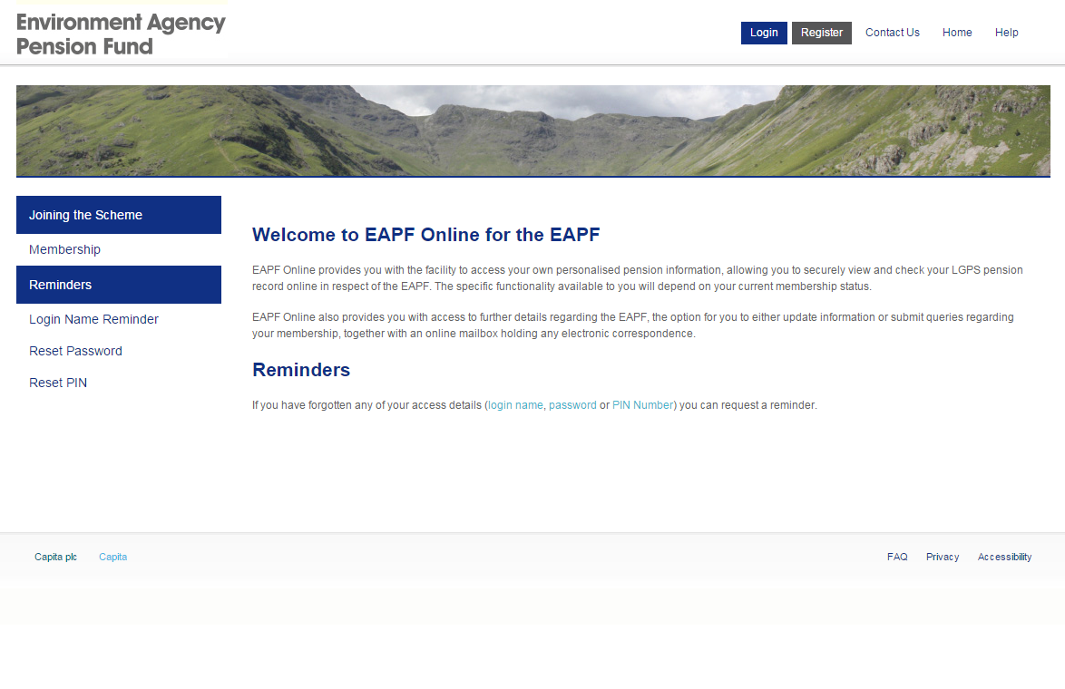

How has my pension changed since April 2014?
Contributing members briefing 2015
Taking control: going digital
accessible straight from eapf.org.uk

Slide 30

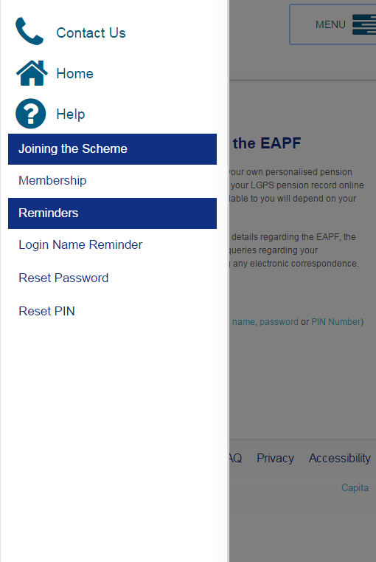
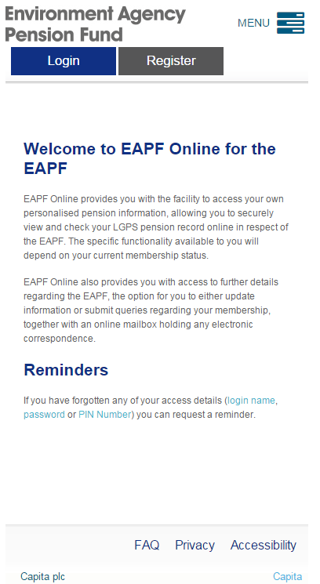
How has my pension changed since April 2014?
Contributing members briefing 2015
Taking control: use your mobile

Slide 31
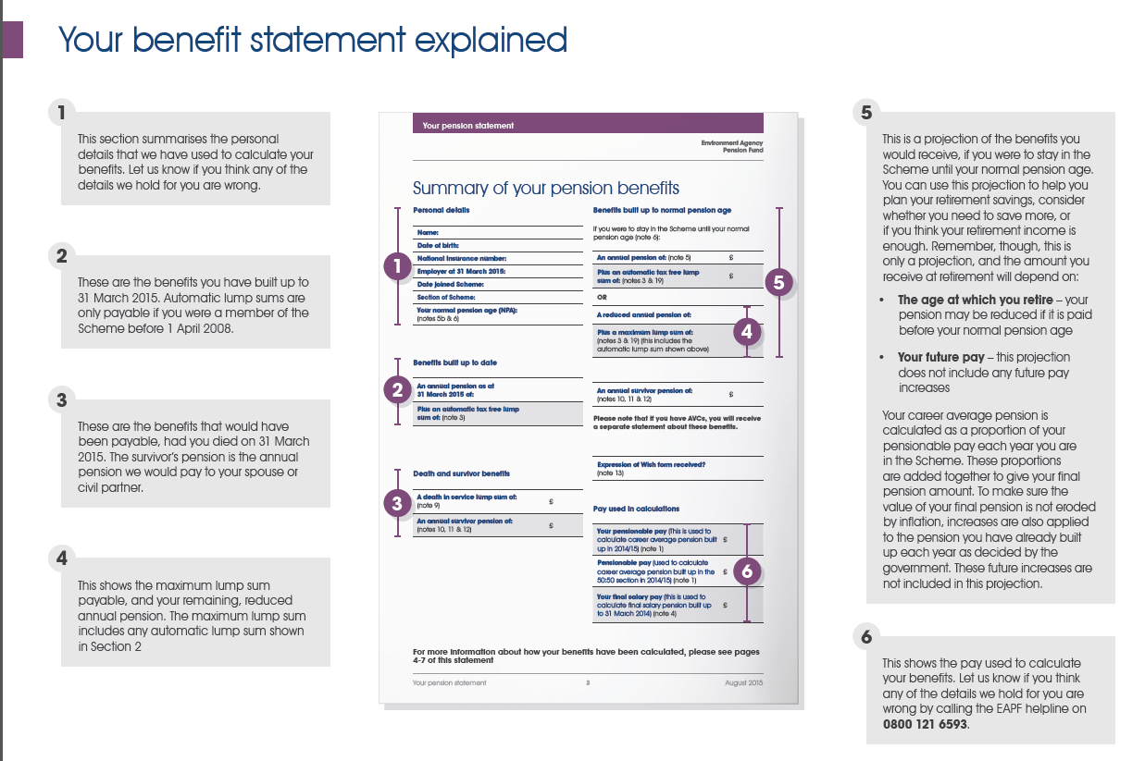
Contributing members briefing 2015
Taking control: Understanding your statement
—
Notes:
David

Slide 32

Contributing members briefing 2015
Contact us
For general information about the benefits of our Scheme:
go to our pension website at www.eapf.org.uk
telephone 0800 121 6593
To use the calculator and to view your last benefit statement:
go to EAPF Online at www.eapf.org.uk
For points of clarification from today’s webinar:
Email us at info@eapf.org.uk
If you need any further help then:
telephone 0800 121 6593
Notes:
David

Slide 33
Contributing members briefing 2015
Any questions?

Slide 34
Disclaimer
Contributing members briefing 2015
This briefing has been compiled by Capita, unless stated otherwise on individual slides and is based on our understanding of legislation and events on 10 September 2015. The figures and situations quoted in all of the slides are merely examples and are not intended to constitute advice, nor should they be considered a substitute for specific advice in relation to your individual circumstances. Capita accepts no liability for errors or omissions.
If you require advice on this subject you should contact an independent
financial advisor.

